Slide 1
Readout Error Mitigation (3)
Inverting the Circuit, Flipping the Counts and Measuring Expectation Value
November 8, 2020 (Election Weekend)

Slide 2
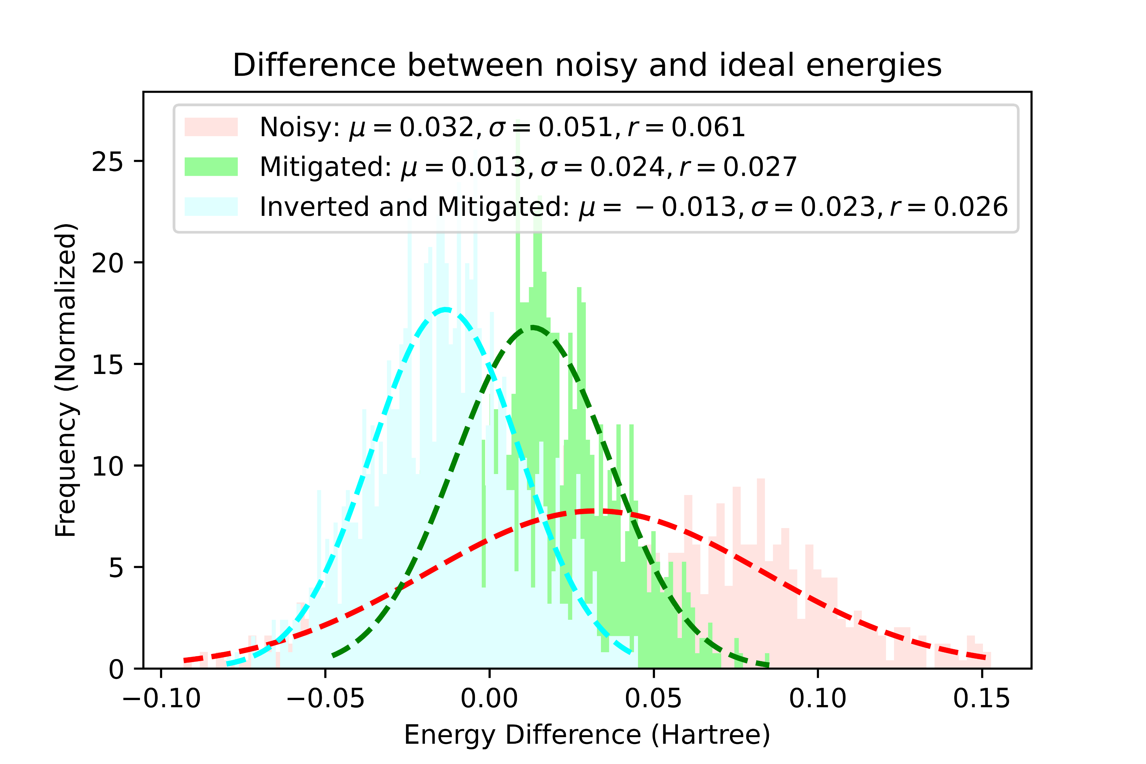
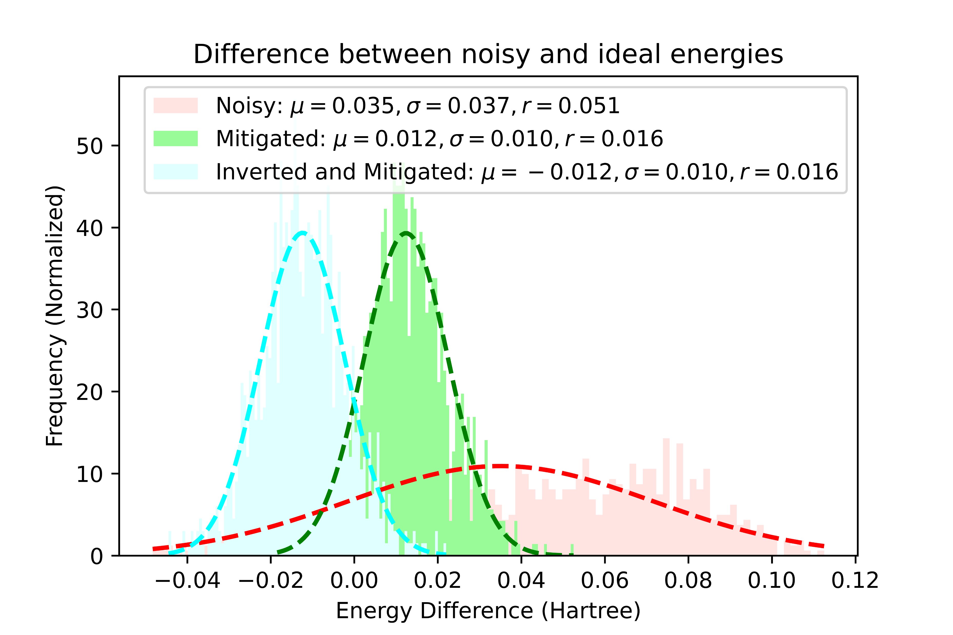
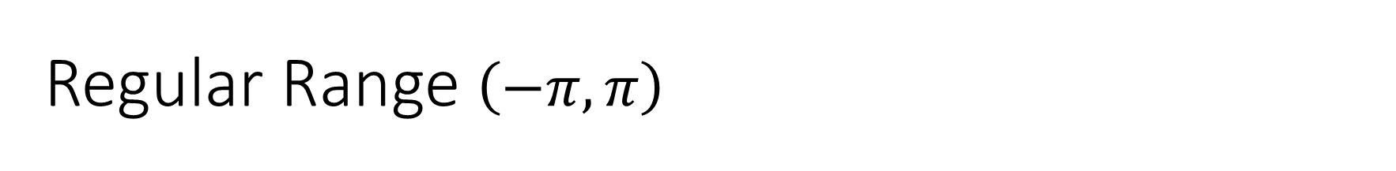
Regular Range $\left(−π, π\right)$
Full Noise Model
Only Readout Errors

Slide 3
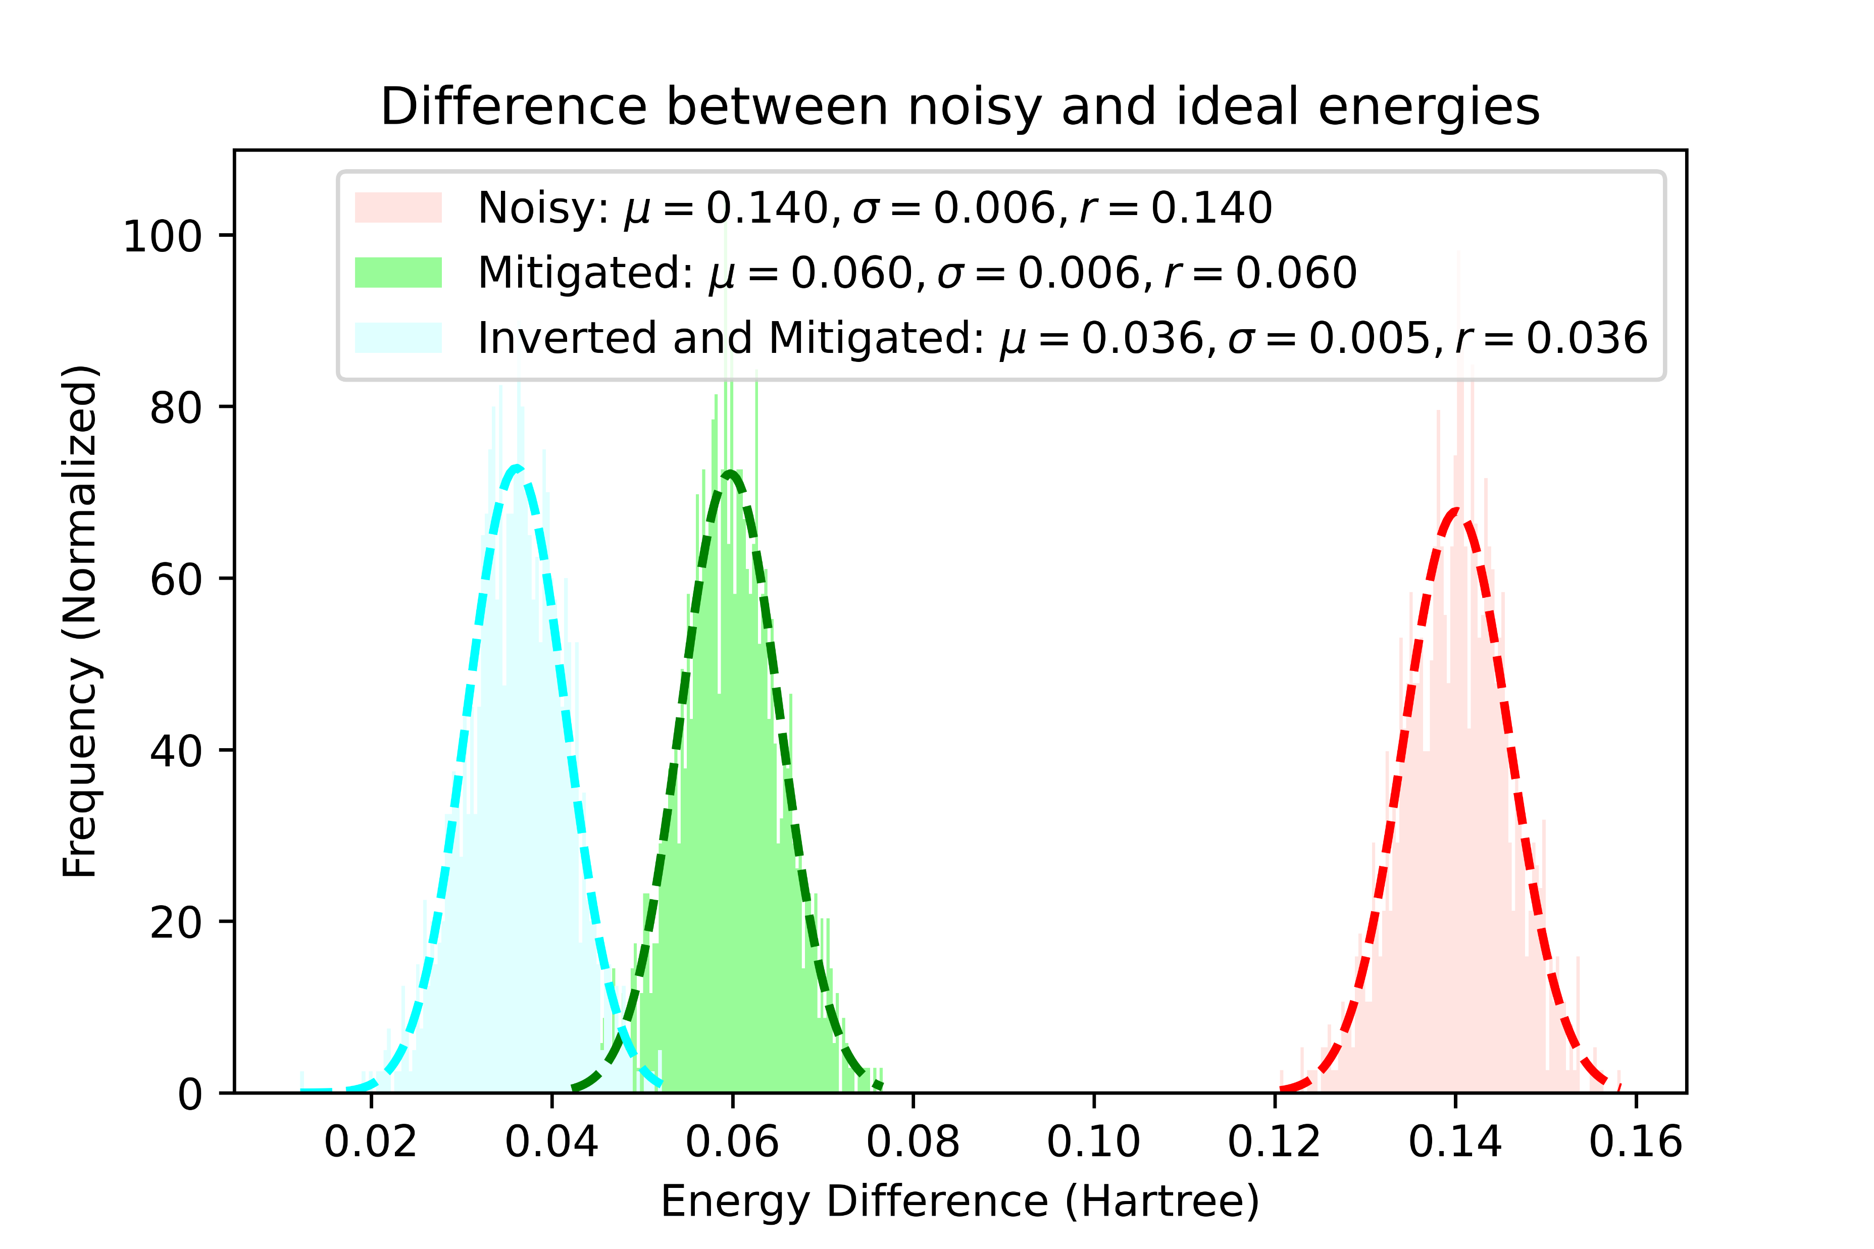
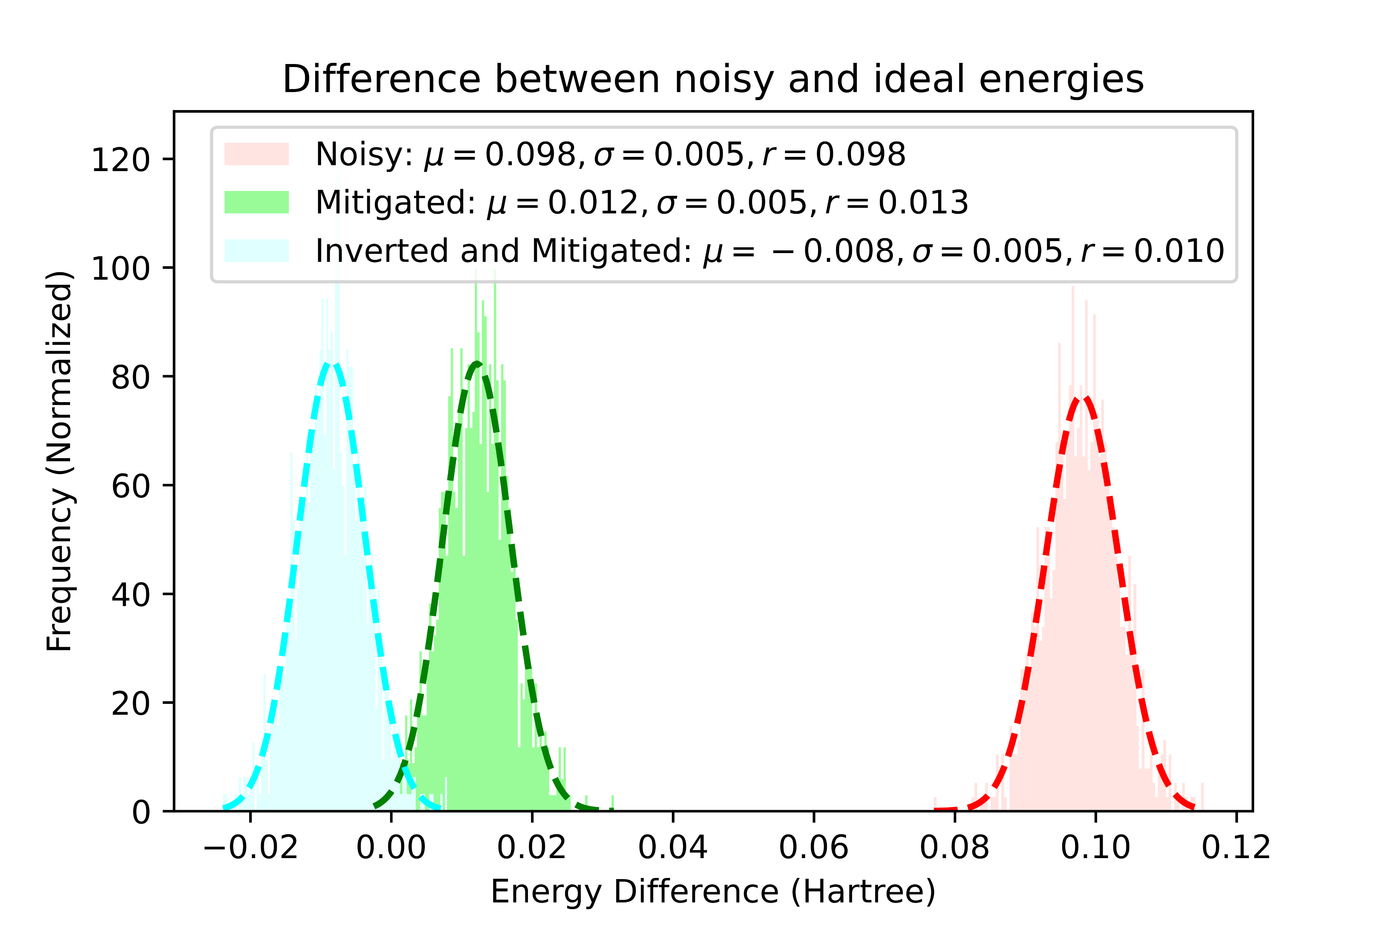
Restricted Range [(0.001, 0.002),(-0.002, -0.001), (-0.2, -0.1)]
Full Noise Model
Only Readout Errors

Slide 4
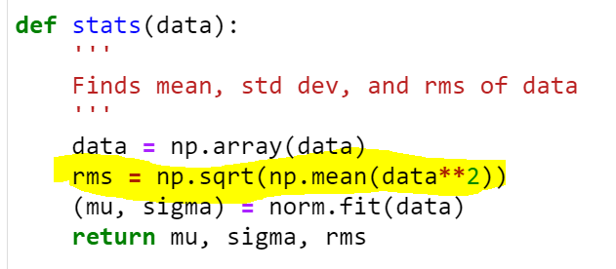
Simulation Info
Ran on FakeBogota Noise Model with each measurement consisting of 10,000 shots
A 1000 different set of parameters sampled from specified range.
RMS values may be incorrect. Here is the code:
Code for these experiments can be found here

